Slide 1


Git Basics GIT Flow
Angel Sevilla camins

Slide 2


planning
Basic Git concepts
Git goodies
Git flow

Slide 3
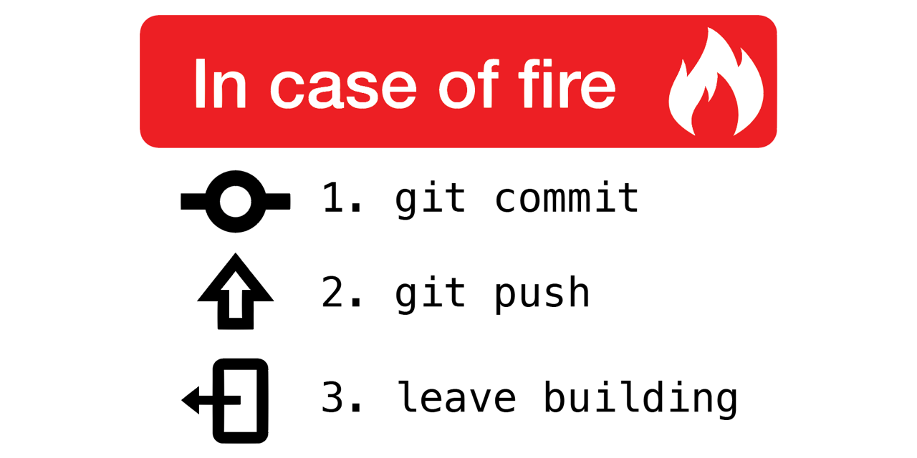
Basic Git concepts

Slide 4
What is Version Control?
Version control, also known as revision control or source control, is the management of changes to a set of data over time. The most important purposes are:
It keeps track of all changes made to a file
As changes are tracked, a history of different versions is tracked and different versions can be recalled
It can merge different versions of a file, which allows team members to edit the same file

Slide 5

What is git?
Distributed version control system
Stupid content tracker
“I’m an egotistical basterd, and I name all my projects after myself” -- Linus Torvalds

Slide 6

Advantages
Fast branching and switching
Shape your own workflow
Work everywhere
Git goodies

Slide 7
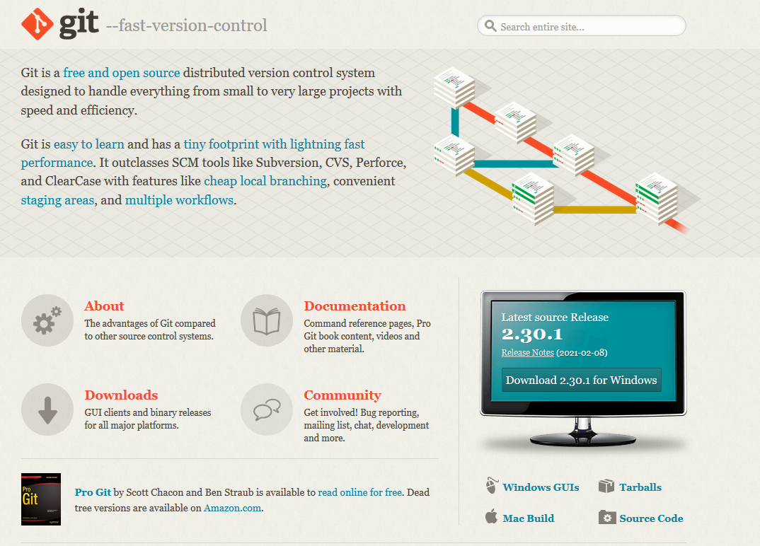
Getting starting with Git
Installing Git -> https://git-scm.com/
git config: View and/or change configuration settings
Settings that will be used for all projects, add the --global flag.
git help: Display a list of the most common commands that are available

Slide 8
Exercise: Setting things up
$ git config --global user.name "Firstname Lastname"
$ git config --global user.email "name@company.com"
$ git config -- list

Slide 9
rEPOSITORIES
A repository holds the set of files and directories that are under version control.
The repository will track all changes that are made to the files or directories.
Note that it's not going to store every old version, only the changes.
Resides in the .git directory on your hard disk
repository

Slide 10
Exercise: Setting things up
$ mkdir Recipes
$ cd Recipes
$ git init
$ git status

Slide 11
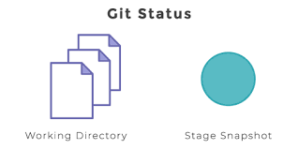
What’s the status?
git status
The working directory and the index

Slide 12
Working Directory
Contains a state of the project
working
directory

Slide 13
Index
The starting point of a modification.
Helps preparing commits
Every commit goes through this
Aka “cache” or “staging area”
index

Slide 14
Index
working
directory
index
repository

Slide 15
Exercise: Creating content
$ nano VegetableSoup.txt
$ git status
On branch master
Initial commit
Untracked files:
(use "git add <file>..." to include in what will be committed)
VegetableSoup.txt
nothing added to commit but untracked files present (use "git add" to track)

Slide 16
Using the Index
git commit -am
git add
git commit -m
working
directory
index
repository

Slide 17
Exercise:
$ git add VegetableSoup.txt
$ git status
On branch master
Initial commit
Changes to be committed:
(use "git rm --cached <file>..." to unstage)
new file: VegetableSoup.txt

Slide 18
Exercise:
$ git commit -m "My first commit"
[master (root-commit) 8940ea2] My first commit
1 file changed, 1 insertions(+), 0 deletions(-)
create mode 100644 VegetableSoup.txt

Slide 19
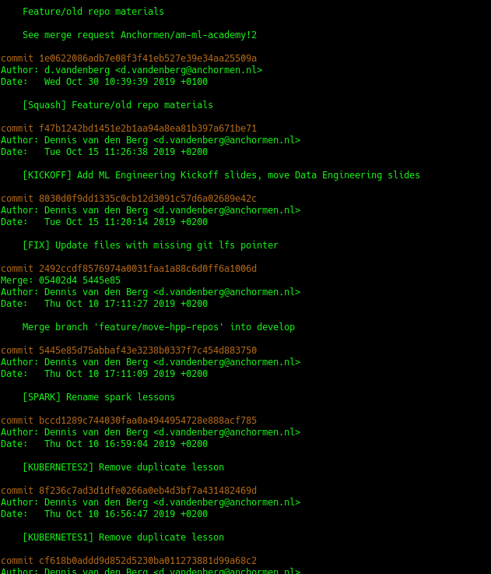

Commit history
git log

Slide 20
RESET
git reset --hard HEAD
git reset <FILE>
working
directory
index
repository

Slide 21
Exercise:
$ # Make mistakes and correct them
$ # Unstage a file
$ touch wrong.file
$ git add wrong.file
$ git status
# Restore from repository
$ rm wrong.file
$ rm VegetableSoup.txt

Slide 22

Building a narrative
Use the index to build and shape your commits
Committing is about telling a story on how the work progressed
“Separate your concerns” also applies here
Resolving conflicts, cherry-picking and, ultimately, release planning will be much easier
Like a lot of things in software: It seems like extra work, but it actually saves time

Slide 23

TITLE
Branching

Slide 24
Branching
git branch new_branch
git checkout new_branch
git checkout –b new_branch
HEAD
master
new_branch

Slide 25
Exercise:
$ git log
$ # create a new branch new_branch and switch to it
$ git log
$ # Open the VegetableSoup recipe again and add some more ingredients
$ # Save the file with the changes
$ # Commit the changes, so the changes are saved (don't forget to specify which changes should be tracked!)

Slide 26
Branches
master

Slide 27
Branches
master
develop

Slide 28
Merge
master
develop

Slide 29

Merging
git checkout master
git merge new_branch
Optional: resolve conflicts when necessary
See if there are any with git status
Edit file(s)
Add to index
git commit

Slide 30
Exercise:
$ # switch back to new_branch and merge it on master
$ # Remove old branch
$ git log

Slide 31
Rebasing
master
https://www.atlassian.com/git/tutorials/merging-vs-rebasing
git rebase master
Much cleaner project history
Perfectly linear project history
The golden rule of git rebase is to never use it on public branches
new_branch
https://www.atlassian.com/git/tutorials/merging-vs-rebasing

Slide 32

Other Repos

Slide 33
Remotes
local
push
remote
pull

Slide 34
Remotes
remote
remote
remote
local

Slide 35
Cloning
git clone <URL>
remote
local

Slide 36
Initialize remote repository
git remote add origin <URL>
remote
local

Slide 37
Exercise:
$ # go to GitLab and make your own repository in the Academy Playground group
$ # copy the url from the dropdown
$ git remote add origin $url

Slide 38
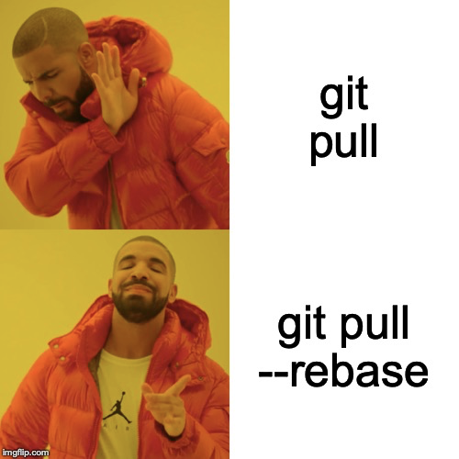
Updating
git pull --rebase
remote
local

Slide 39
Sharing work
git push
remote
local

Slide 40
Exercise:
$ git push -u origin --all
$ # see your commit history at GitLab

Slide 41
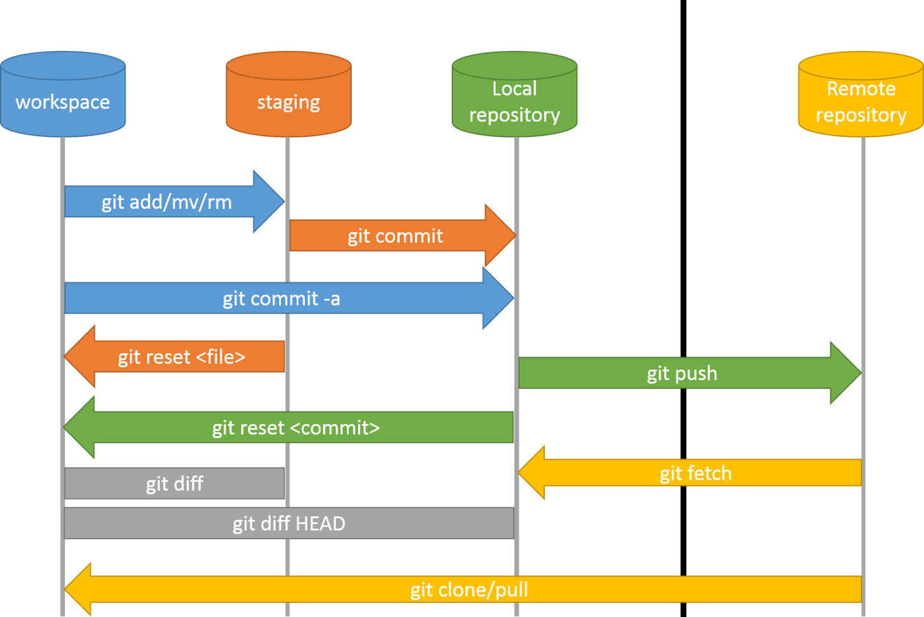
Summary:
https://alinex.gitlab.io/env/git/

Slide 42

TITLE
Goodies

Slide 43

Goodies
Cherry-picking
Reverting
Stash
Amending commits
LFS

Slide 44
Cherry picking
develop
git cherry-pick hash
cherry
cherry
feature
https://www.atlassian.com/git/tutorials/cherry-pick

Slide 45
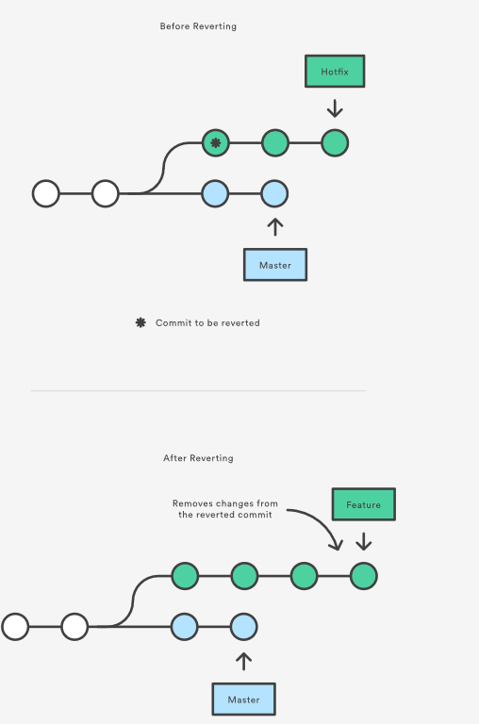
Reverting
git revert hash
Creates a new commit
https://www.atlassian.com/git/tutorials/resetting-checking-out-and-reverting

Slide 46
Exercise:
$ # create a wrong commit and push it to GitLab
$ # revert the last commit and push it to GitLab
$ # view the difference in Gitlab

Slide 47
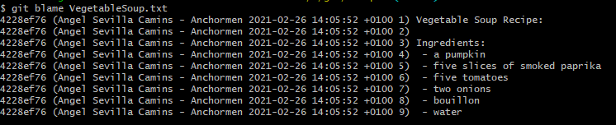
BLame
https://www.atlassian.com/git/tutorials/merging-vs-rebasing
git blame <FILE>
https://www.atlassian.com/git/tutorials/inspecting-a-repository/git-blame

Slide 48

Stash
Temporarily ‘stash’ changes in working directory
Acts as a stack: Push/pop stashes
git stash
git stash pop

Slide 49
Exercise:
$ # Add ‘another ingredient’ to VegetableSoup.txt
$ git status
$ git stash
$ git status
$ git stash pop
$ git status
$ git commit –am ”added additional ingredient”

Slide 50
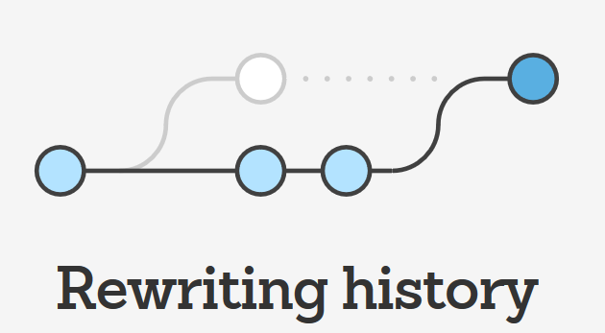

Amending
Add/remove changes
Change commit message
Will generate new commit hash
Do not change published history!
Shared commits should not be altered

Slide 51
Exercise:
$ # change the “Another ingredient” to a real ingredient
$ # To add the change to the index
$ git add VegetableSoup.txt
$ git commit --amend
$ git status
$ git push

Slide 52
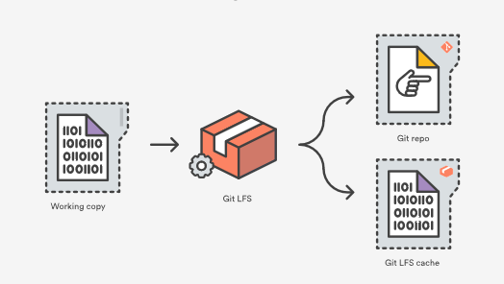
LFS
Git LFS replaces big files contents with a pointer
Stores the file contents in a local Git LFS cache

Slide 53
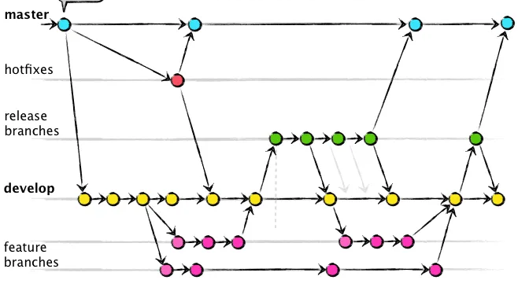
TITLE
Git flow

Slide 54

Git Flow
Popular branching model.
Main branches
master
develop
Supporting branches
Feature branches
Release branches
Hotfix branches
https://nvie.com/posts/a-successful-git-branching-model/
https://danielkummer.github.io/git-flow-cheatsheet/

Slide 55
Exercise: Setup GIT-Flow
$ # install git-flow
$ git flow init
$ # Add and finish a new feature
$ # Add and finish a new release

Slide 56
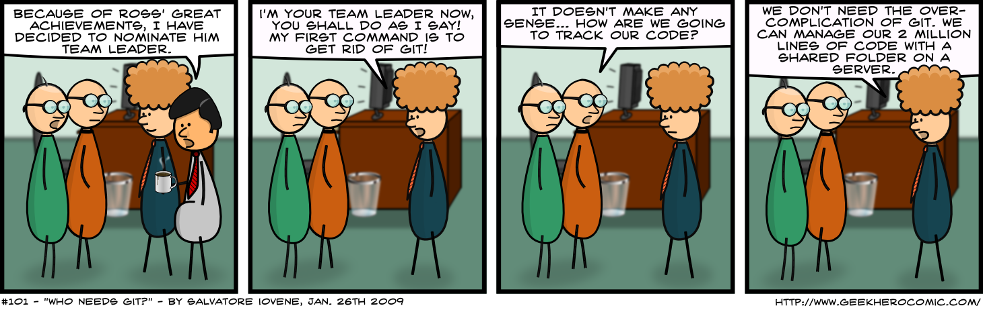
Questions?

Slide 57
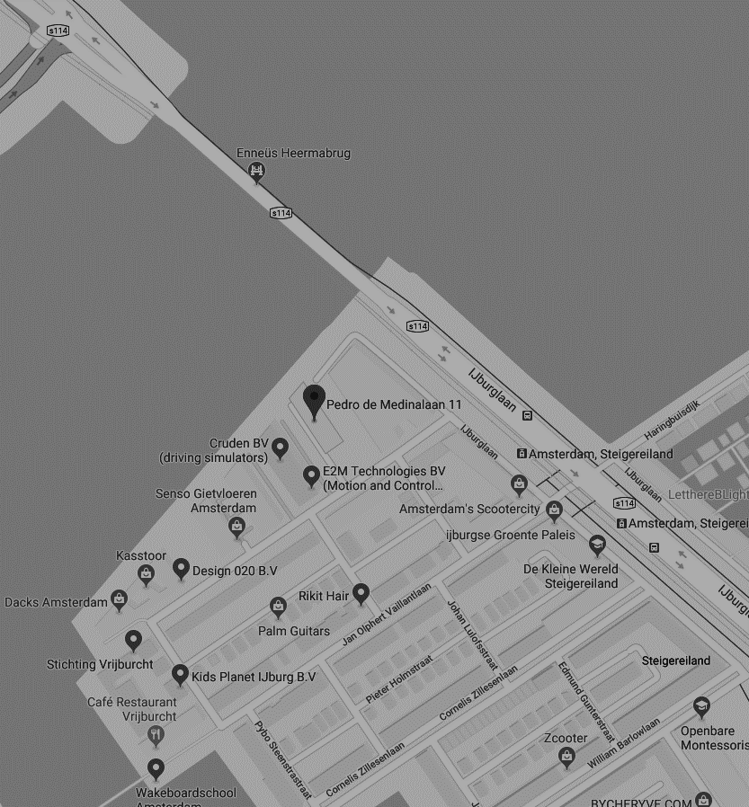
THANK YOU FOR YOUR ATTENTION
Pedro de Medinalaan 11, 1086 XK Amsterdam
020 - 773 1972
www.anchormen.nl

